Slide 1

Creating a Winning LinkedIn Profile
Don Proeschel
Director of Corporate Relations
Jonsson School of Engineering & Computer Science
University of Texas at Dallas

Slide 2

Don Proeschel Bio
BS in Nuclear Engineering from West Point
MS in Management and Administration from UT Dallas
Six years as an Army telecommunications officer
18 years in defense electronics companies (infrared systems, antennas, radars, stealth technology, cyber security and software modeling and simulation)
15 years in IT and telecom companies in executive roles
Worked for companies from 7-person startups to Texas Instruments
Decades of experience in staffing, recruiting and career coaching
Connected with 8,000+ recruiters on LinkedIn
Passion for helping others connect with their dream jobs

Slide 3
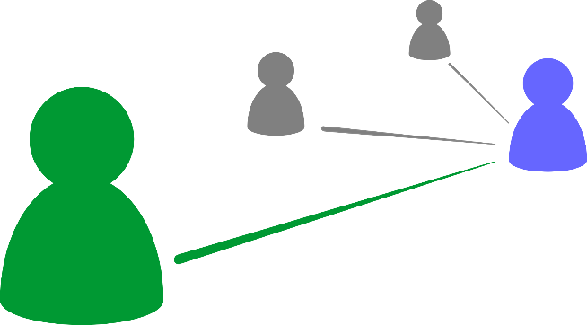
Recent Recruiter Connections
Joined LinkedIn June 14, 2004.
Achieved 20,000 first-level LinkedIn connections on 9-3-2018.
First-level recruiter connections in August 2018 included:
*Fidelity *PriceWaterhouseCoopers (PWC) *Facebook
*Amazon Web Services *Keurig Dr. Pepper *General Motors
*Microsoft *Lennox International *Stryker *Oracle *Apple
*Texas Instruments *Charles Schwab *Ericsson * IBM *Bayer
*NTT Data Services *Lockheed Martin *Verizon *Georgia-Pacific
*General Electric *Accenture *Google *Nestle *Samsung
*General Dynamics *Continental Electronics
All of these companies’ recruiters connected with me in the month of August 2018. There are more, but these are the ones that most people know.

Slide 4

Client Testimonial
“I would recommend Don not only as a resume writer and a Linked In format expert, but also as a dedicated job coach. He was a good listener, very professional and always readily available. Don is always on time and kept in contact constantly. His work was completed exceeding my expectations and he was very easy to work with. His fee was extremely competitive and fair. I am 100% satisfied!!”
Review from client on 9-5-2018 who was a former Senior Vice President at Jiffy Lube.

Slide 5
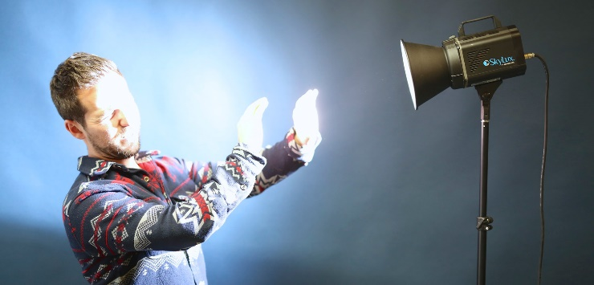
How Bright is the Job Market?
GDP growth (4.2%) is greater than unemployment
rate (3.9%).
Dallas area unemployment rate is 3.8% vs.
5.3% long-term average rate.
NASDAQ and S&P 500 at all-time record highs, and Dow Jones is getting close.
More total job openings in USA than job seekers.
120,000 new jobs in North Texas each year.
You only need one of these jobs!

Slide 6
How Bright is the Job Market?
For experienced engineers, median salaries
in the Dallas area for:
Biomedical engineers: $111.3K
Electrical engineers: $104K
Mechanical engineers: $104.3K
Computer hardware engineers: $107.5K
Software systems development engineers: $110.5K
In 2017, USA 90th salary percentile was $108K.

Slide 7


Who is in Marketing and Sales???

Slide 8
Who is in Marketing and Sales???
You are!!!!!
You are your “brand.”
You are marketing and selling your services.
Your resume and LinkedIn profile are your primary branding tools to attract recruiters and hiring managers.
Nearly every industry uses LinkedIn to find and vet candidates.
Over 90% of recruiters rely on LinkedIn.
This is your online professional reputation. Take control of it!
Users who list their education appear in searches 17 times more often.
Indicating preferred work location will make you appear in 23 times more searches.

Slide 9

Agenda
LinkedIn Purpose and Principles
Your Photo
Headline
Summary Section
Dashboard and Profile Strength
Resume
Articles & Activity
Experience
Education
Volunteer Experience
Skills & Endorsements
Recommendations
Accomplishments
Interests

Slide 10

LinkedIn Profile Purpose
There is exactly ONE purpose for your LinkedIn profile:
To get an INTERVIEW! (Same purpose as your resume)
It is NOT intended for you to tell your whole life story.
It is intended to create interest by employers in learning more about the value you can bring to an organization.
Your goal is to differentiate yourself from the many other candidates who are competing for every job.

Slide 11
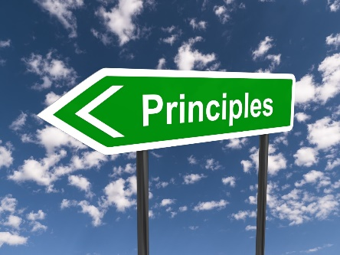

Linkedin Principles
There are two ways to connect with hiring companies:
You reach out to them.
They reach out to you.
With a solid LinkedIn profile, you allow hiring company recruiters to search for and find you 24 X 7.
The FIRST thing recruiters will do upon receipt of your resume is go to your LinkedIn profile. Does it present the best professional version of you right now?
Edit your LinkedIn URL to match your name:
www.linkedin.com/in/donproeschel

Slide 12
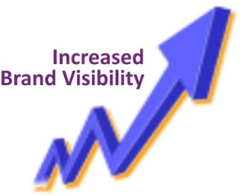
Increase Your Brand Visibility
Join up to 100 groups based on location, industry & discipline and post comments on group articles.
Indicate on your profile that you are open to new job opportunities:
Profile → Settings and Privacy → Job seeking preferences → Let recruiters know you’re open to open to opportunities → Select “Yes”
Indicate that you want your profile visible to everyone:
Profile → Settings and Privacy → How others see your profile and network information → Edit your public profile → Your profile’s public visibility → Select “On”
Post status updates 3-4 times weekly to move up in SEO searches
Indicate your location (where you are or where you want to work)

Slide 13
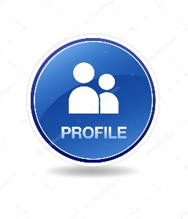
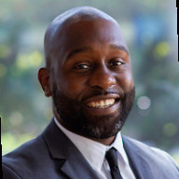
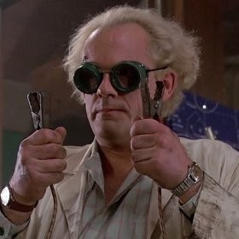
Improving Your Profile
Professional looking photo is a must-have! Profiles with photos get:
21 times more views OR ????
36 times more messages
Headline
Match it to the job you are seeking or currently have.
Include your email address and phone number.

Slide 14

Summary Section Elevator Pitch
Begin with your “elevator pitch” of the value you bring to an employer. It is best to write in first person. Tailor your message to your target audience. Project confidence but not arrogance.
Example: I help connect and maintain relationships with high-tech companies in North Texas seeking to partner with UT Dallas, including our outstanding engineering students, faculty and staff.

Slide 15


Summary Section Strengths & Skills
List these alphabetically to help find them easily.
Include strengths and skills from job postings of positions that you are seeking.
Example:
Communications skills (written and verbal)
Java programming
Product development life cycle
Team leadership

Slide 16

Resume
First, make your resume excellent.
Next, upload your resume into the Summary Section.
Whenever you edit your resume, put your latest version into the Summary Section.

Slide 17

Dashboard and Profile Strength
This is visible only to you.
Seek to have a profile with an “All Star” rating—the highest.
Look at your profile now—what is it rated?
What makes your profile complete?
Your industry and location
An up-to-date current position (with a description)
Two past positions
Your education
Your skills (minimum of 3)
A profile photo
At least 50 connections

Slide 18

Dashboard and Profile Strength
51% of profiles are complete, and 49% are not at the All Star level.
Profile Strength meter is on the right side of your profile and gauges how robust your profile is. Strength increases as you add more content.
Move and hover your cursor over the circle in the box to view the next level of strength you can reach. You can click the Improve Your Profile Strength link for a tour thatll guide you through adding content to your profile.
Profile strengths:
Beginning
Intermediate
Advanced
Expert
All Star

Slide 19
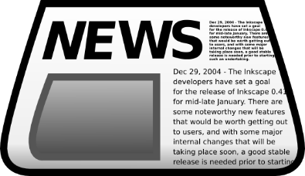
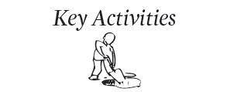
Articles and Activity
Reviews of books and news articles
Blog posts on topics of interest to employers in your industry
When your followers “like” a posting, your LinkedIn profile moves higher in searches conducted by hiring managers

Slide 20
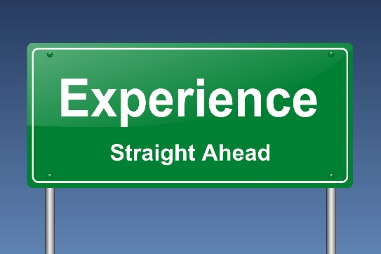
Experience
Make this match your resume.
Show accomplishments and not just job responsibilities.
Managing Director of Federal Systems, No Magic, Inc., Nov 2011 – Jan 2014
Allen, TX
• Directed the activities of the Federal Systems Business Unit, significantly improving business planning and capture, financial planning and analysis, and program delivery. • Developed proposals and successfully led delivery of complex software modeling solutions to large Defense Contractors, such as CACI and CSC, on time and within budget. • Co-authored successful cyber security proposal to the NSA. • Co-authored and successfully managed technical value proposition document. • Mentored junior team members in leadership and the Department of Defense systems acquisition cycle.

Slide 21

Education
Show university education to date.
Include projected graduation date.
Do not include high school education—not relevant to an employer.
Show education honors (Dean’s List, etc.).
Include activities and societies (IEEE, SWE, ASME, etc.)

Slide 22

Volunteer Experience
100 hours of community service are now required for undergraduate Jindal School of Management incoming freshmen (soon coming to Jonsson School of Engineering and Computer Science) per Dallas Morning News 8-30-2018.
Most companies today publicly support and promote community service by their employees.
Many truly care about their communities.
This also helps to enhance their marketing “brand” as good corporate citizens.
Community service demonstrates that a candidate is a well-rounded person who will do more than just work to draw a paycheck.

Slide 23
Volunteer Experience Example
Past Chairman, Collin County Open Space Board
Past Co-Chairman of $30 Million Collin County Open Space bond proposition
Past Chairman, City of Allen Parks and Recreation Board
Past mentor and leadership seminar keynote speaker, Dallas Junior Chamber of Commerce
West Point recruiter, counselor and interviewer in Plano High Schools
Past member, University of Texas at Dallas Industrial Advisory Board
STEMFire volunteer, serving as science project judge at all levels, from elementary to UT Dallas
Past Dallas Morning News contributing writer, Friday “Sounding Off” section

Slide 24
Skills & Endorsements
Compile a list of skills needed in a job posting for a position that you are seeking.
Add to this list other related skills that are not in that posting.
Add these to your profile in this section.
Encourage others in your network to indicate that you possess these skills by having them click the buttons for these skills.
Each click by someone in your network is an endorsement that you possess that skill.
The skills with the greatest number of endorsements should be the most important skills valued by the company posting the job you want.

Slide 25
Skills & Endorsements Example
Compile a list of skills needed in a job posting for a position that you are seeking.
Industry Knowledge
Business Process Improvement
See 182 endorsements for Business Process Improvement99+
Project Management
See 176 endorsements for Project Management99+
Process Improvement
See 141 endorsements for Process Improvement99+
Strategic Planning
See 93 endorsements for Strategic Planning93

Slide 26

Recommendations
Years ago, people had hard copies of letters of recommendation.
LinkedIn recommendations are today’s letters of recommendation and are available for recruiters to see 24 X 7.
You can request recommendations from others as well as give recommendations to others. Example:
Don Proeschel is a phenomenal team builder and process engineer. His knowledge of ISO 9001, CMMI, DoD Acquisition, Project/Program Management and his superior ability to communicate, lead, mentor, and collaborate have made it my absolute pleasure to work with Don. He is also a patriotic veteran and a man of great moral fiber, whom I respect sincerely. (from Ben Moreland, former colleague)

Slide 27
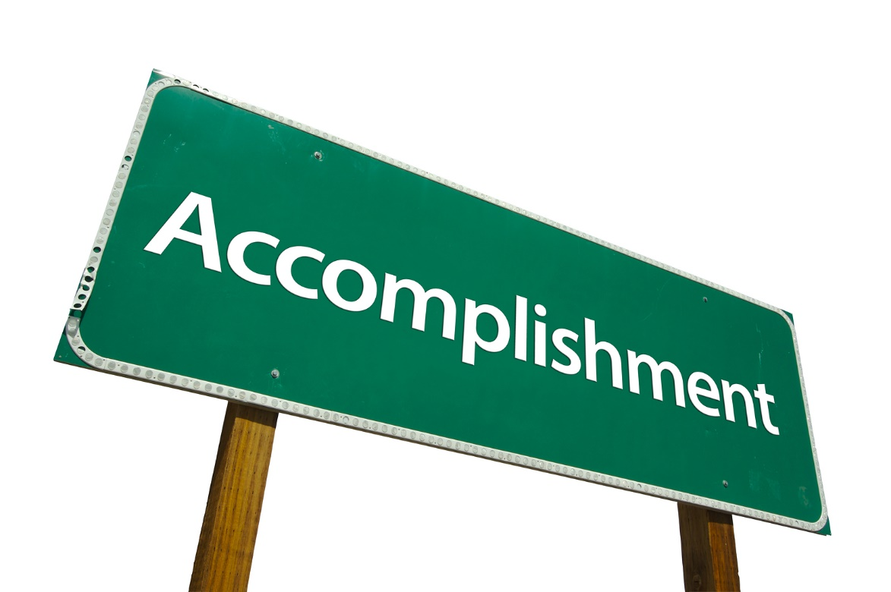
Accomplishments
Publications
Certifications
Patents
Courses
Projects
Honors and Awards
Test Scores
Languages
Organizations

Slide 28

Interests
Shows people and organizations you are following
Influencers
Companies
Groups
Schools

Slide 29

Additional Resources
www.careerdfw.org (A one-stop shop for conducting a job search)
http://utdmaker.space/ (New library of online job search resources)
https://utdallas.edu/career/resources/ (List of outstanding staff and online resources at UT Dallas)

Slide 30

Q & A Time

Slide 31

Contact Information
Don Proeschel
Director of Corporate Relations
Jonsson School of Engineering and Computer Science
don.proeschel@utdallas.edu
972.883.3928
www.linkedin.com/in/donproeschel

